Slide 1
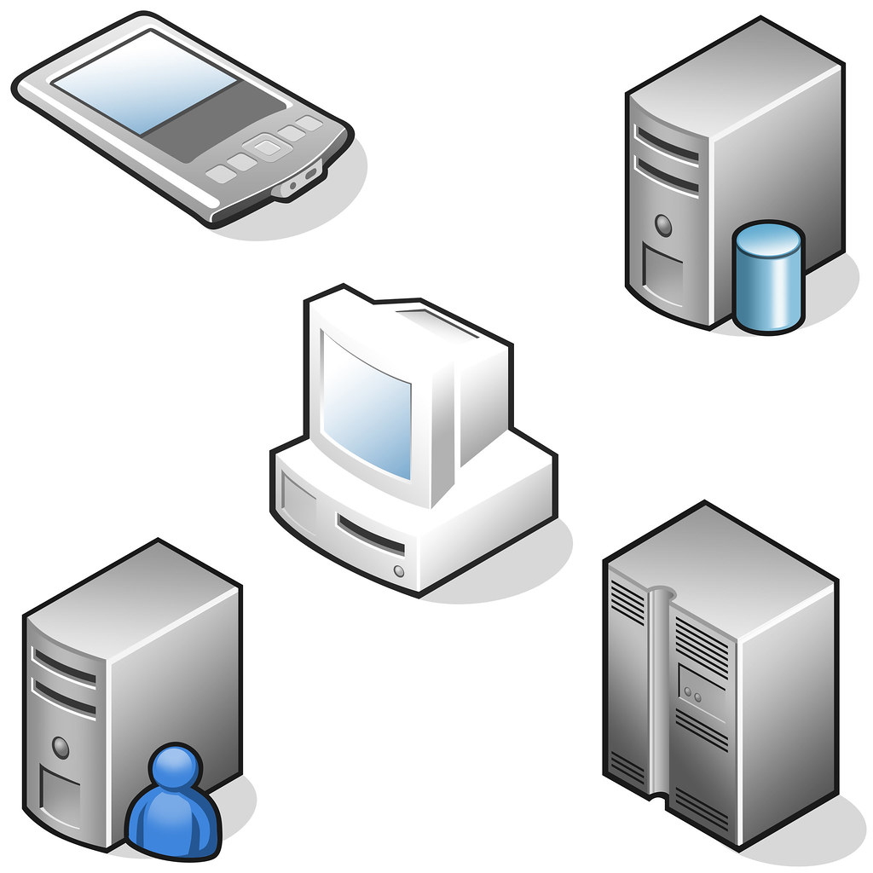

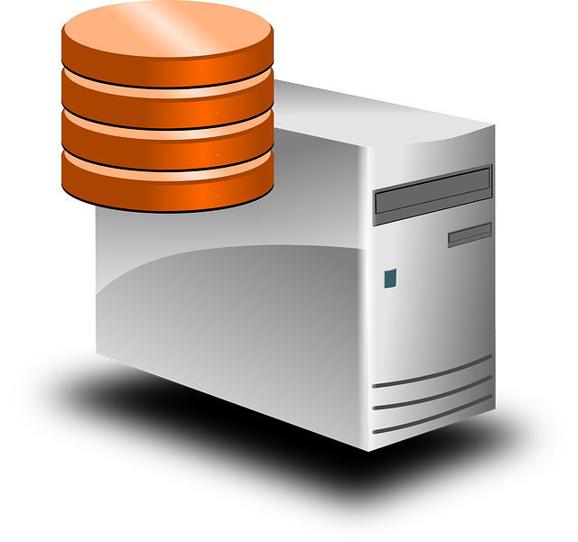
Microservices
Client Controller
Brokerage
Credit Authorization
Notes:
We have all tasted the Kool-Aid of Microservices, and we are hooked to varying degrees. Microservices split function and development into pieces, which are independently scalable according to their load
Also, you can leverage polyglot teams for development, so you can have Java, or Node, or whatever

Slide 2

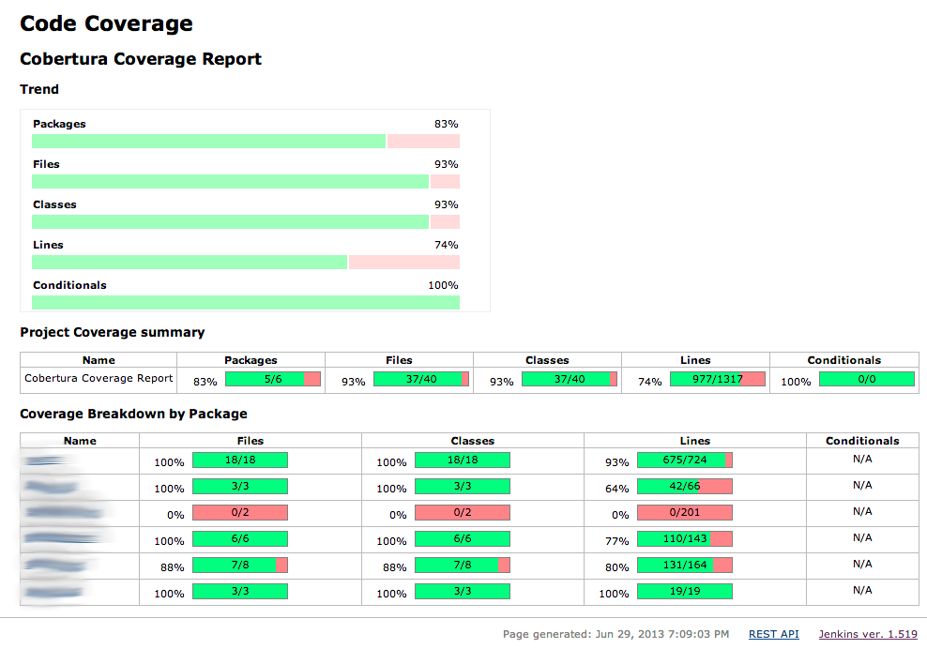
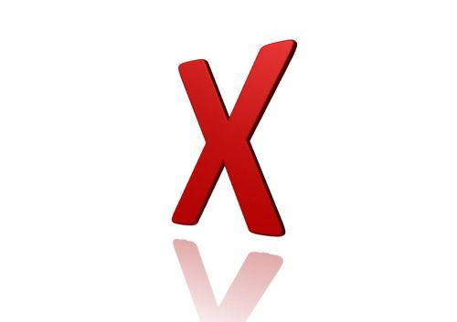


Challenges of Testing Microservices
You have high test coverage
All your service build tests are green
But what about the gateway endpoints? Do the services you call still support the endpoints you need?
How can you ensure all up & down stream dependencies are playing nicely?
One solution – Deploy all microservices, and test in-vivo.
But that requires infrastructure and team/version coordination
Notes:
You’ve built your 12 Factor microservices application, all tests pass with 95% coverage. Then you deploy to production, and kapow! Rollback!
What happened? – Well, your tests all passed but the consumers never tested their endpoints against the producer!

Slide 3
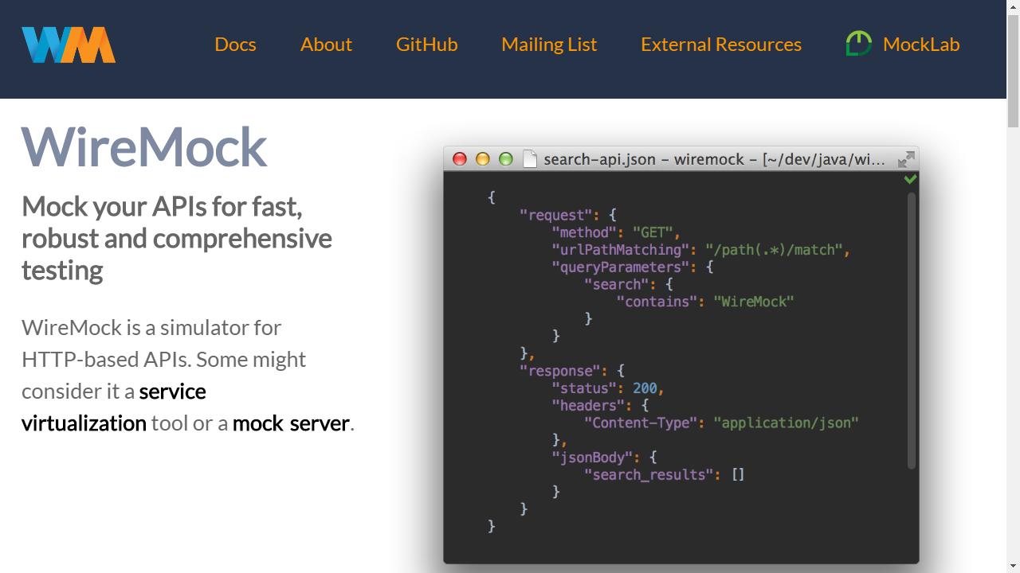
Mock your APIs for fast, robust and comprehensive testing
WireMock is a simulator for HTTP-based APIs. Some might consider it a service virtualization tool or a mock server.
Provides a way for consumers to mock dependencies, without having to spin up all services that comprise their application

Slide 4

Microservices
WireMockStub
Client Controller
Broker
Broker
Credit Line Increase

Slide 5
Client Stub
Requests regex map to consumer endpoints
{ "id" : "ae7f4f91-0e0e-45ba-8aa9-3d84bc8ccb12", "request" : { "url" : "/request-credit-increase", "method" : "POST", "headers" : { "Content-Type" : { "matches" : "application/json.*" } }, "bodyPatterns" : [ { "matchesJsonPath" : "$[?(@.['currentCreditLine'] =~ /-?(\\d*\\.\\d+)/)]" }, { "matchesJsonPath" : "$[?(@.['increaseAmount'] =~ /-?(\\d*\\.\\d+)/)]" }, { "matchesJsonPath" : "$[?(@.['clientId'] == 1)]" } ] }, "response" : { "status" : 200, "body" : "{\"date\":\"2019-08-14\",\"clientId\":{{{jsonPath request.body '$.clientId'}}} ,\"denialReason\":null,\"increaseAmount\":20000}", "headers" : { "Content-Type" : "application/json" }, "transformers" : [ "response-template" ] }, "uuid" : "ae7f4f91-0e0e-45ba-8aa9-3d84bc8ccb12" }

Slide 6

But who makes sure the ever-changing stubs remain in sync?

Slide 7
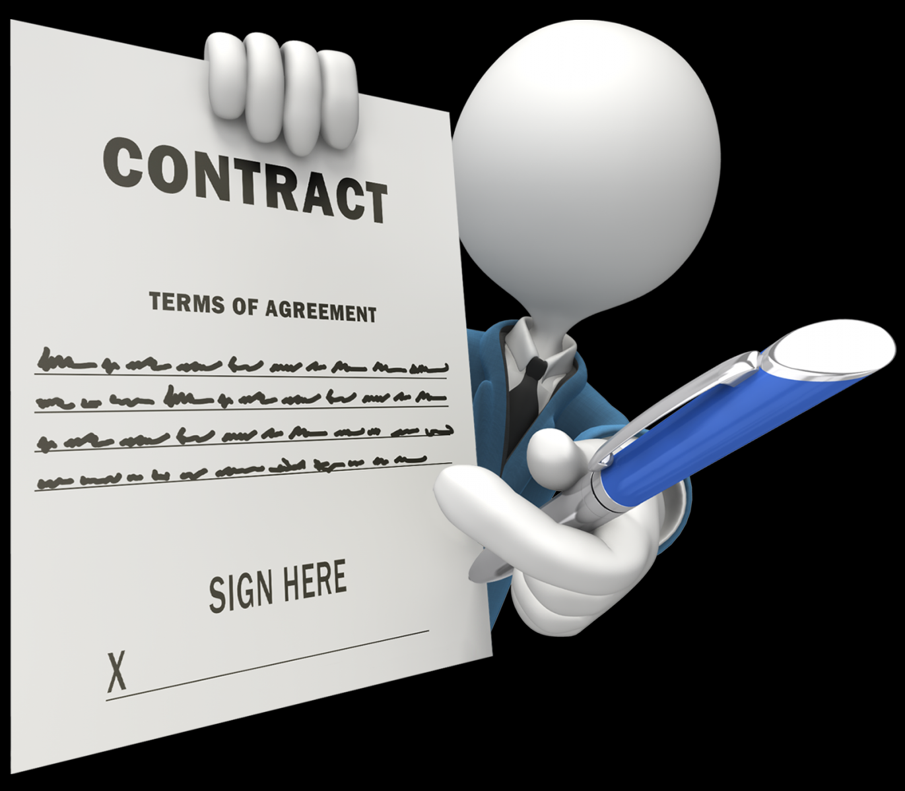
Contracts to the Rescue
A contract (aka “Pact”) gives the consumer the certainty that the stubs that you use were created by the service that you call.
If you can use them, it means that they were tested against the producer’s side. In short, you can trust those stubs.

Slide 8
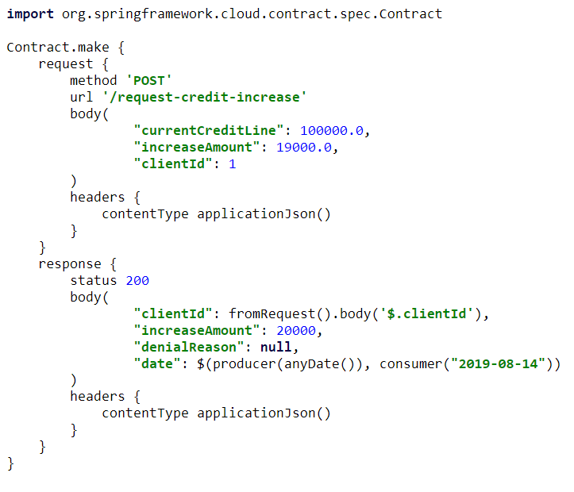
Contracts
A contract defines the interactions between a consumer and a provider.
Includes request, response, protocol, headers, bodies, parameters … anything that defines an endpoint
Consumer
Regular expressions can match contract request to stub endpoints.
Stub runner returns predefined responses in consumer tests.
Provider
Contract defines actual “Producer” values as inputs, and “Consumer” Regex for testing results.

Slide 9
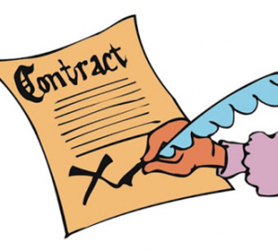
Consumer Driven Contracts Workflow
TDD approach, where contracts are shared by consumers & providers
Consumer writes a (failing) test that exercises the call to the provider
Consumer forks a local copy of the provider project
Consumer defines contracts in the provider project, to generate stubs
Consumer creates a pull request to share the contract
Provider side automatically generates provider verification tests, which will fail, (since the functionality is not yet implemented)
Provider makes the tests pass by implementing the new functionality
By sharing contracts, we are guaranteed there will never be an impedance mismatch between the client and the provider
Provides current feedback, without setting up new infrastructure.

Slide 10
Spring Cloud Contract
Groovy-based DSL for defining shared contracts
On Consumer side, automatically generates stubs for consumer testing
Stub-runner plugin downloads and executes the provider APIs
On Provider side, automatically generates contract verification tests

Slide 11
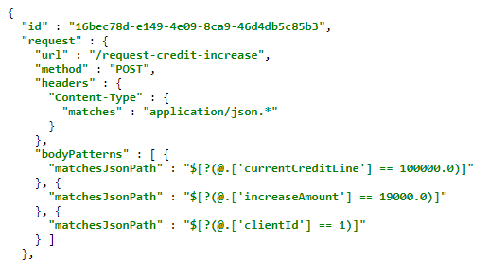
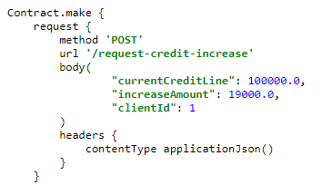
test

Slide 12
Server Generated Test
@Test public void validate_shouldNotIncreaseCreditLimitIfNoAvailableCredit() throws Exception { // given: MockMvcRequestSpecification request = given() .header("Content-Type", "application/json")
.body("{\"currentCreditLine\":100000.0,\"increaseAmount\":1099000.0,\"clientId\":2}"); // when: ResponseOptions response = given().spec(request) .post("/request-credit-increase"); // then: assertThat(response.statusCode()).isEqualTo(200); assertThat(response.header("Content-Type")).matches("application/json.*"); // and: DocumentContext parsedJson = JsonPath.parse(response.getBody().asString()); assertThatJson(parsedJson).field("['increaseAmount']").isEqualTo(0); assertThatJson(parsedJson).field("['clientId']").isEqualTo(2); assertThatJson(parsedJson).field("['date']").matches("(\\d\\d\\d\\d)-(0[1-9]|1[012])-(0[1-9]|[12][0-9]|3[01])"); assertThatJson(parsedJson).field("['denialReason']").isEqualTo("Credit line has reached its max. Available: 900000.0"); }

Slide 13
Automated Tests
Both consumer and provider tests are executed against the same contract every time they run a build.
A breaking change on either side will automatically fail the build on the other side
Development is coordinated, in a TDD fashion…
make a change on the consumer, break the build on the provider, fix the implementation on the provider, get the tests to pass

Slide 14
Provider vs. Consumer-Driven Contracts
Provider Contracts – API producer maintains the contracts for all its consumers. Useful for:
Producers that cannot directly collaborate with their consumers - e.g. there are many consumers or they’re external
Consumer-Driven Contracts - Consumers play a vital role in the process of creating the contracts:
Easy to implement when both producer and consumer teams work for the same organizations
Number of consumers is not extremely large.

Slide 15

USEFUL LINKS
A step-by-step guide to Consumer Driven Contracts with Spring Cloud Contract: https://cloud.spring.io/spring-cloud-contract/
The three-second or three-minute tour give you a nice very brief walkthrough of Spring Cloud Contract.
Consumer Driven Contracts and Your Microservice Architecture by Marcin Grzejszczak (@mgrzejszczak) and Adib Saikali (@asaikali).
Implementation of the consumer driven contract library Pact for Javascript, from creating a test to generating the contract and uploading it to the Pact broker.
Spring Cloud Contract / Pact Integration: https://ordina-jworks.github.io/spring/2018/04/28/Spring-Cloud-Contract-meet-Pact.html

Slide 16
Consumer Driven Contracts with Spring Cloud Contract
Consumer Driven Contracts – development model for specifying shared contracts, to generate endpoint tests in the form of executable stubs.
Consumers use those contracts to spin up mock environments.
Producers testify that they conform to those contracts.
Contracts are stored in a mutually accessible repository.
Notes:
It would be great if we could spin up a complete integration test environment, but let’s face reality – even if we could, that might take time to pull the right versions together, replicate production data, etc.
Consumer Driven Contracts is a development model for specifying contracts that are shared by providers and consumers, to generate endpoint tests in the form of executable stubs.
The consumers spin up mock environments based on those contracts.
The producers testify that the conform to those contracts
And the contracts are stored in a mutually accessible repository

Slide 17
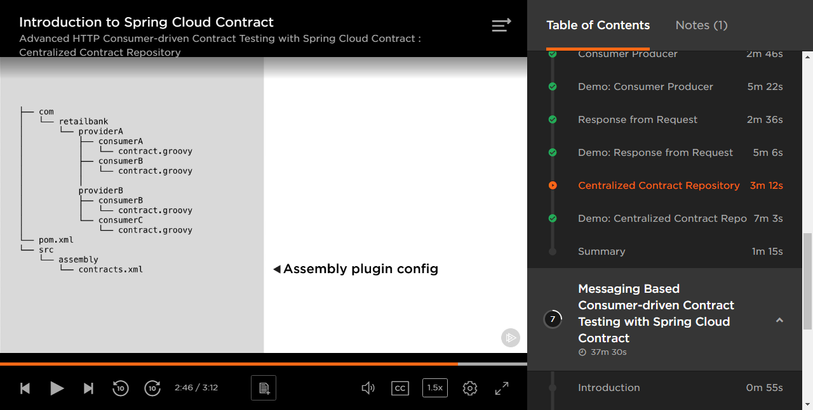
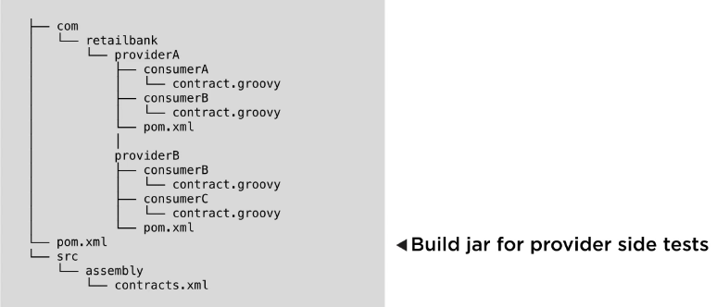
Centralized contract repo

Slide 18
Consumer Driven Contracts
TDD approach, where contracts are shared by consumers & providers
Spring Cloud Contract automatically generates stubs of all dependencies and launches them in WireMock, so your consumer tests can call them without spinning up all the real microservices
On the provider side, tests are generated to verify that all calls provided in the contracts produce the results specified in the contracts
Since the contracts are shared, if the provider changes the contract, the consumer side tests will fail, and vice versa.
This provides instant, accurate, and current feedback, without setting up tons of infrastructure.

Slide 19
Contract verification
Mock MVC
Explicit web server
Jax RS

Slide 20
Our Brokerage application
Brokerage client account, with credit verification provider

Slide 21
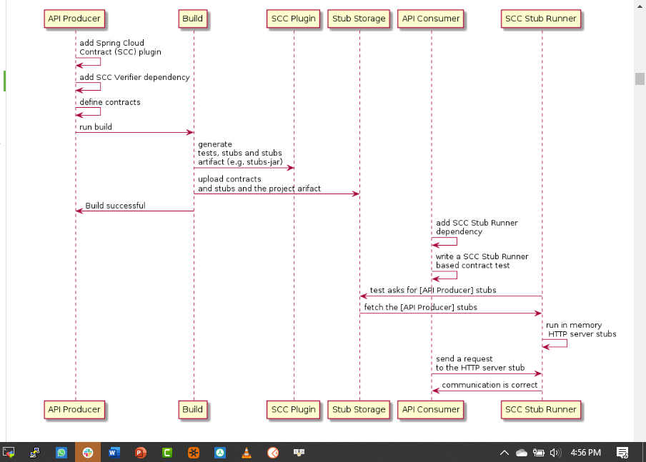

Slide 22
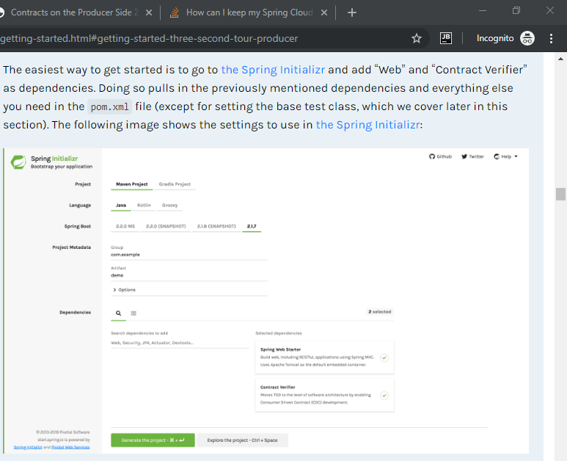

Slide 23
Strategies
Contract in Provider project
Contract in separate Git repo
Contract in Nexus or Artifactory

Slide 24
Consumer Driven Contracts with Spring Cloud Contract
In this talk, we will build a client and server application, and see how all our unit tests pass.
Then we will show how they fail when deployed.
Finally, we will see how Spring Contracts could have saved a lot of heartache.
We will take a brief look at the underlying testing frameworks:
MockMvc
WireMock API testing framework
RestAssured testing framework
Mockito, JsonPath
We present an overview of Consumer Driven Contract, including
Spring Contracts, and some of its underlying technologies, including:
Project organization; POM dependencies
Contract syntax
Generating stubs from contracts
Running the stubs on the consumer side
Versioning
Verifying the stubs on the producer side
Finally, how do we deal with non-Java consumers and/or providers?

Slide 25
To do
example – buy order –chck available funds
Discuss how to deal with common classes, such as request and response classes
Discuss the BaseContractTest class
Research how to store contracts in Nexus / Git
Research how to test contracts against live services
research Groovy contract DSL - setting up request/response, urlPath(){queryParameters{parameter(key, value) }}
file() execute() – see infoq 10:35 Marcin Grzejsczak
explain consumer()/producer()
describe stubs – spring=-cloud-maven-plugin to generate wiremock stubs
@AutoConfigureStubRunner- can dedlare properties 14:04
JsonPath
grab workflow from 18:00

Slide 26
Consumer Workflow
Consumer writes a test for the feature by doing TDD. Consumer writes the contract, which will generate the stub.
Consumer writes the implementation to get the test to pass.
Git commit triggers CI pipeline, which runs the build and uploads all defined contracts to a central repository, e.g. a Pact broker.
Consumer team pushes the code…
then clones the producer’s application.
Consumer team creates a test that uses the newly added contracts and file a pull request.
The provider-code development-team can take over the pull request and add changes where necessary.
https://ordina-jworks.github.io/spring/2018/04/28/Spring-Cloud-Contract-meet-Pact.html

Slide 27
Provider
Provider stores contracts by consumer and contract. So if I change something for a consumer and that consumer doesn’t complain, then I am good to go.
This also encourages consumers to provide contract tests for all of their endpoints. If you change something and their code breaks, you can say “sorry, but you didn’t give me a contract test!”

Slide 28
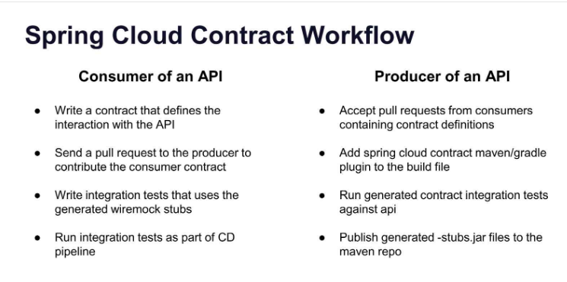
marcin and adib

Slide 29
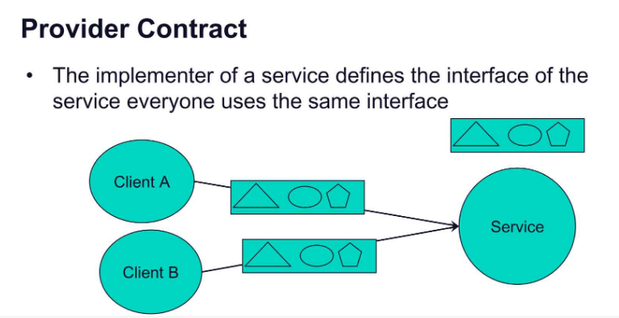
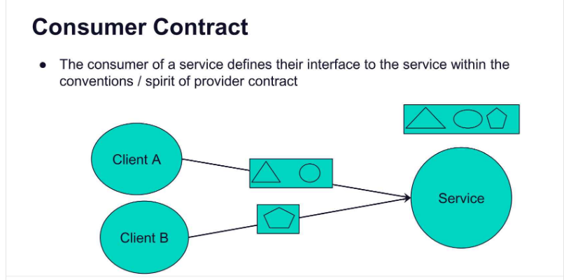
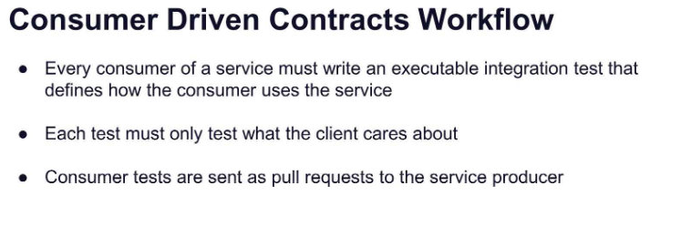

Slide 30
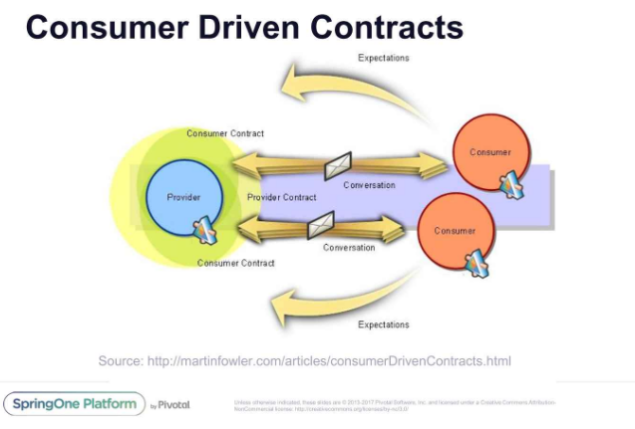

Slide 31
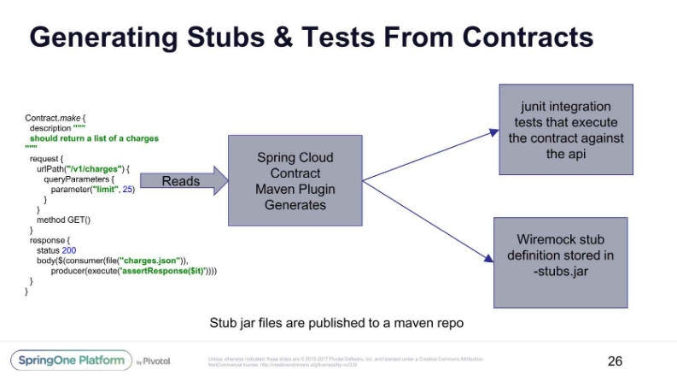
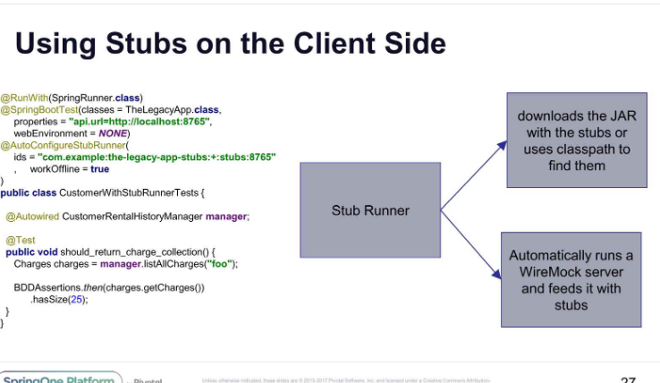

Slide 32
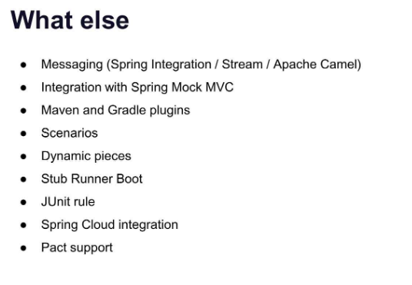
Can run stubs in separate instance
Junit Rule in case you’re not using Spring
Can use Pact files instead of the Groovy DSL

Slide 33
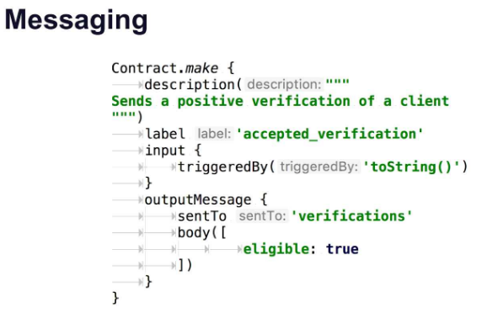
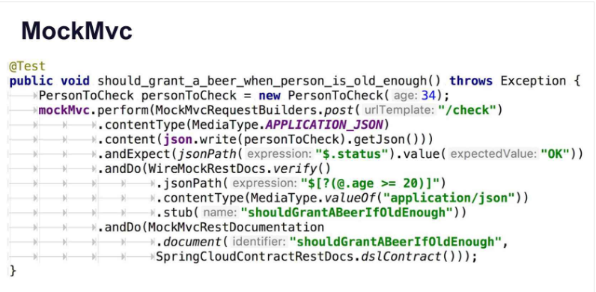

Slide 34
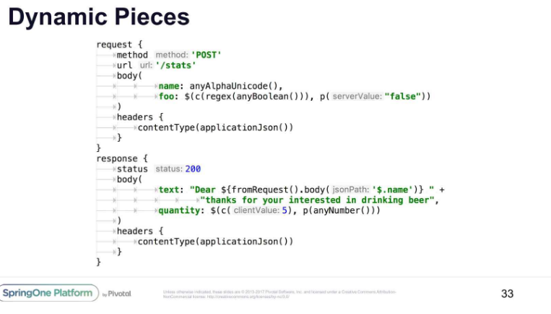
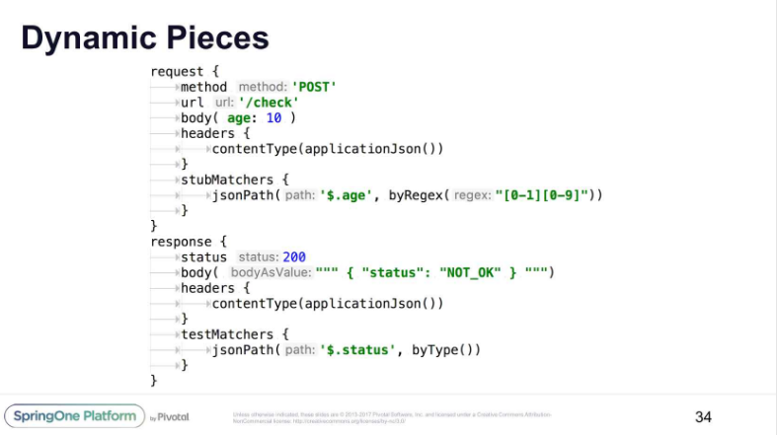

Slide 35
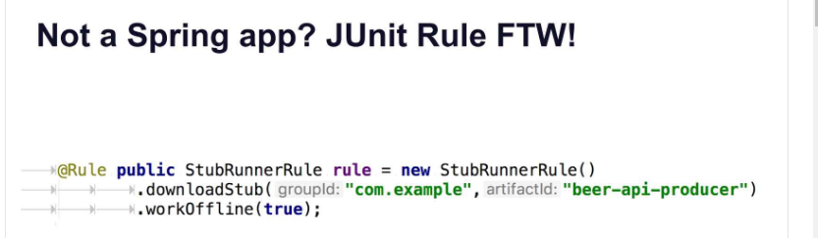
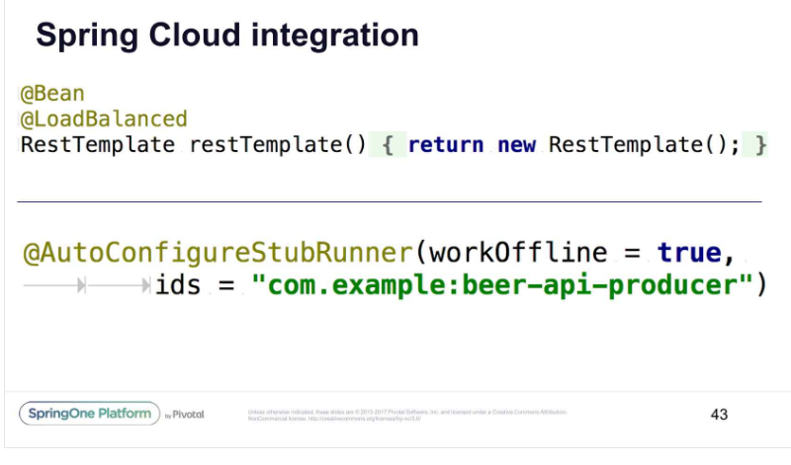

Slide 36
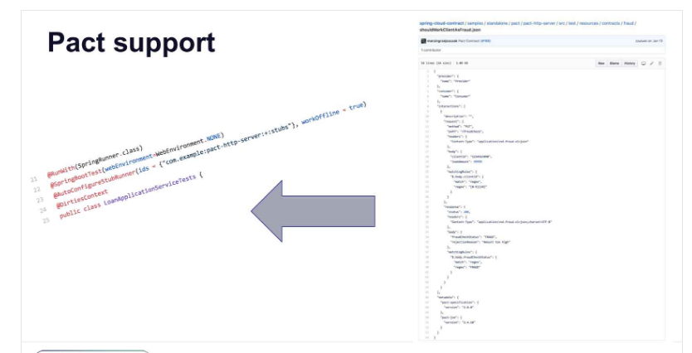

Slide 37
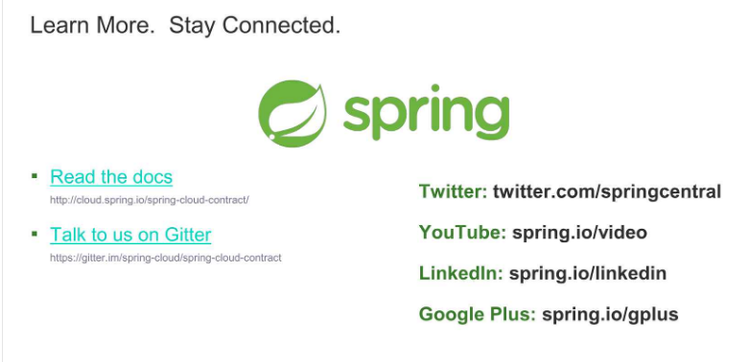

Slide 38
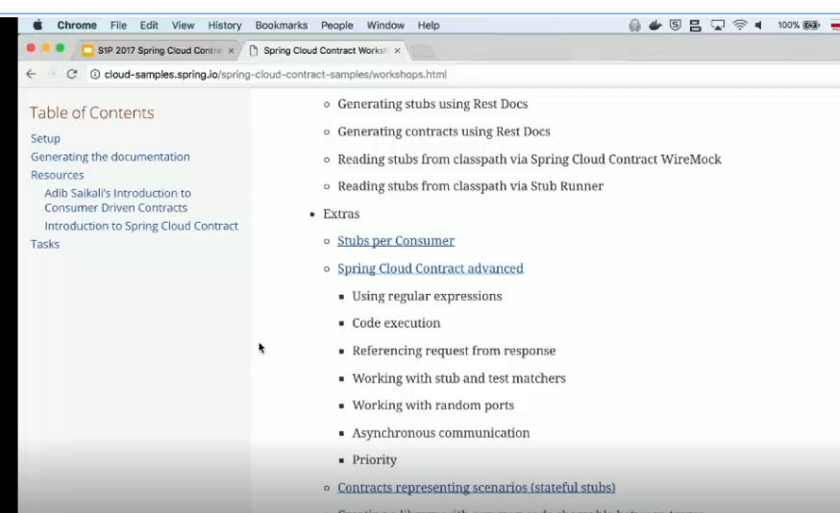

Slide 39
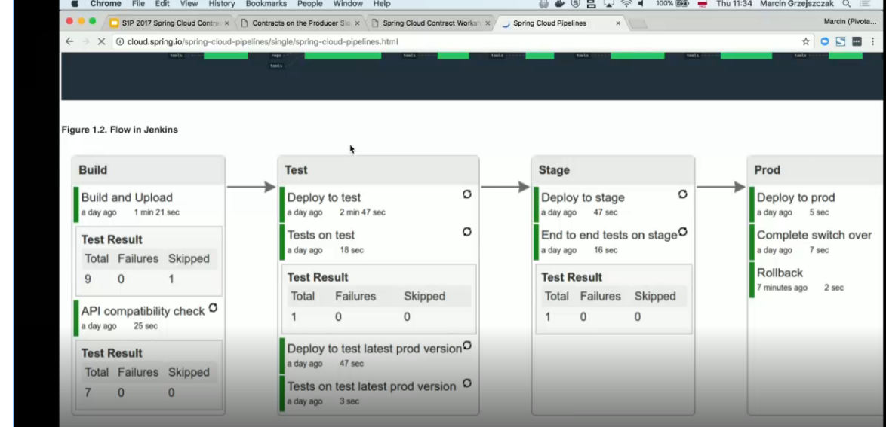

Slide 40
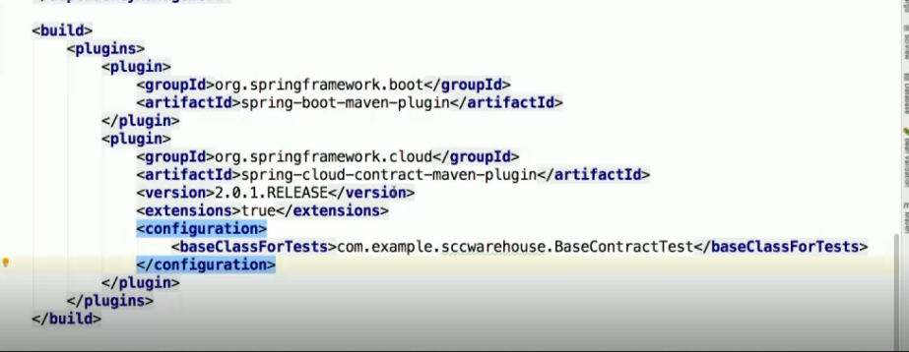
https://www.infoq.com/presentations/spring-cloud-contract/
Summary
Olga Maciaszek-Sharma and Eddu Melendez discuss Spring Cloud Contract,
showing its capabilities to keep producers and consumers working together
correctly and avoid breaking the integration between them.

Slide 41
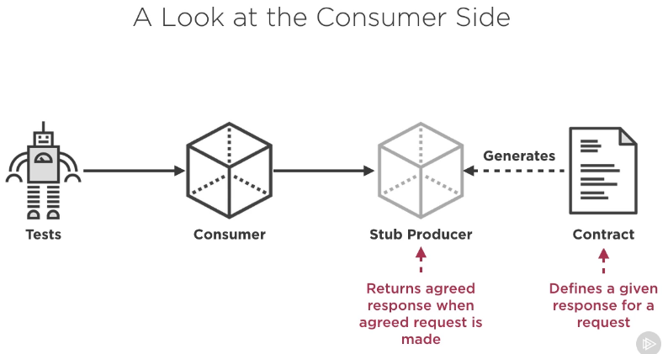
Consumer Side
Write tests that call the Consumer APIs.
Consumer APIs themselves may depend on Providers
Consumer creates a contract that defines the request and response for each Provider API
Spring Cloud Contract will use that contract to generate the stubs required by the consumer to make the tests run

Slide 42
Provider Side
Implement the functionality “driven” by the consumer contracts
Builds the contract verification tests, that make the contract specified requests, and verify that the response matches the contract response

Slide 43
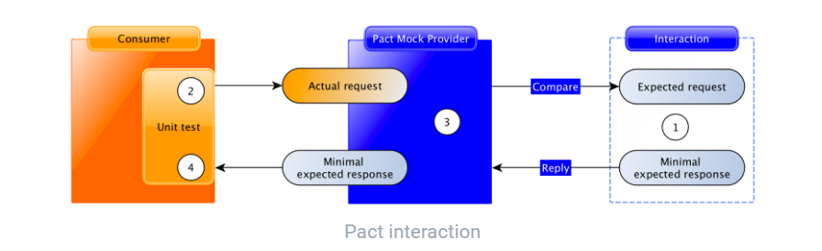
Consumer Pact tests operate on each interaction described earlier to say “assuming the provider returns the expected response for this request, does the consumer code correctly generate the request and handle the expected response?” - https://docs.pact.io/how_pact_works
When writing a test for an interaction, ask yourself what you are trying to cover. Contracts should be about catching:
bugs in the consumer
misunderstanding from the consumer about end-points or payload
breaking changes by the provider on end-points or payload
In short, your Pact scenarios should not dig into the business logic of the Provider but should stick with verifying that Consumer and Provider have a shared understanding of what requests and responses will be. In our example of validation, write scenarios about how the validation fails, not why the validation fails
https://docs.pact.io/best_practices/consumer/contract_tests_not_functional_tests

Slide 44
Graphics
Client testing – Verifies that the given the expected calls and responses, the client will perform correctly
Server testing – Verifies that the contracted requests do produce the contracted response
Consumer driven changes – Tweaks to the consumer -> Tweaks to the contract -> tweaks to the server

Slide 45
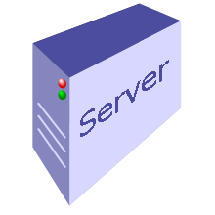
Producer
Consumer
Wire
Mock
Contract Request
Contract Repo
Contract Stubs
Contract Request
Execute request locally
Compare Contract Response
Compare Contract Response
Validate consumer with contracted results

